Slide 1
Understanding Kubernetes [Session 3]
Kubernetes Pattern for Cloud Native Application

Slide 2
Topics
Kubernetes Application Patterns
12 Factor App principle
Kubernetes pattern
Foundational Patterns
Predictable Demands
Declarative Deployment
Health Probe
Managed Lifecycle
Automated Placement
Behavioral Patterns
Jobs
Daemon Service
Singleton Service
Stateful Service
Service Discovery
Self Awareness
Structural Pattern
Init container
Sidecar
Adapter
Ambassador
Kubernetes Patterns (continue..)
Configuration Pattern
Configmap
Env Var
Advanced Patterns
Controller
Operator
Elastic Scale
Garbage Collection
Kubernetes Extensibility
Introduction
Infrastructure Extensibility
API Extensibility

Slide 3
Kube Native Application Pattern
Notes:
What Is CRI?
CRI (Container Runtime Interface) is a plugin interface that allows kubelet to use different container runtimes. Various container runtimes implement the CRI API and this allows users to use the container runtime of their choice in their kubernetes installation.
What is CNI?
CNI project includes a spec to provide a generic plugin-based networking solution for linux containers. It also consists of various plugins which perform different functions in configuring the pod network. A CNI plugin is an executable that follows the CNI spec and we’ll discuss some plugins in the post below.

Slide 4
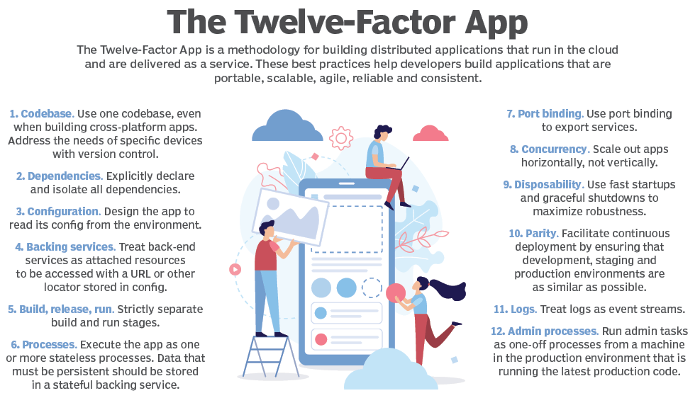
Cloud Native Application Principle

Slide 5
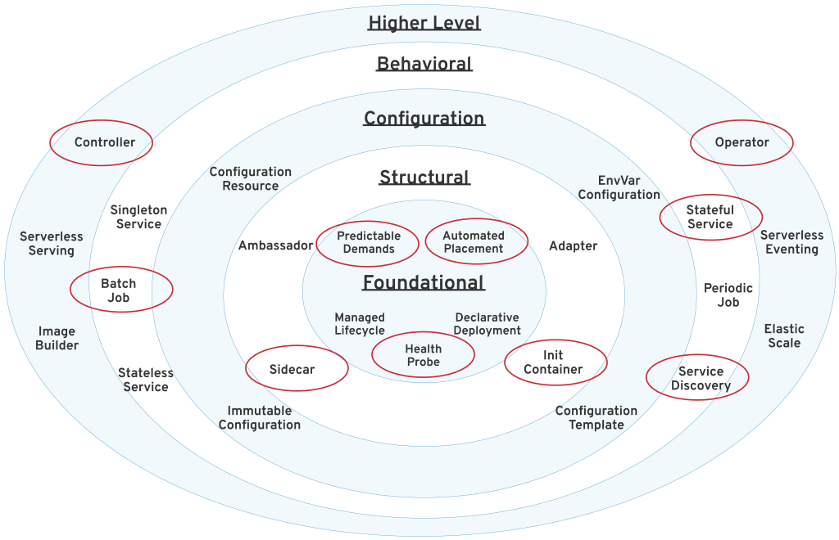
Kubernetes pattern for Cloud Native Applications
A pattern describes a repeatable solution to a problem. Instead of giving step-by-step instructions to solving a problem, a pattern provides a blueprint for solving a whole class of similar problems.
These K8s patterns is to help in design and develop cloud-native applications for the Kubernetes platform. Each object and capability added to Kubernetes represents a foundational tool that has been designed and purpose-built to solve specific need for the software designer.
Foundational Patterns, covers the core concepts of Kubernetes. These are the underlying principles and practices for building container-based cloud-native applications.
Structural Patterns, contains patterns related to organizing containers within a Pod, which is the atom of the Kubernetes platform.
Configuration Patterns, gives insight into the various ways application configuration can be handled in Kubernetes. These are very granular patterns, including concrete recipes for connecting applications to their configuration.
Behavioral Patterns, describes patterns that add finer-grained concepts for managing various types of container and platform interactions.
Advanced Patterns, is a collection of advanced concepts, such as how the platform itself can be extended or how to build container images directly within the cluster.
When Designing/developing/deploy application developer (who is using kubernetes as a cloud native runtime platform) needs to look into these kubernetes patterns as a solution to their application requirements.

Slide 6
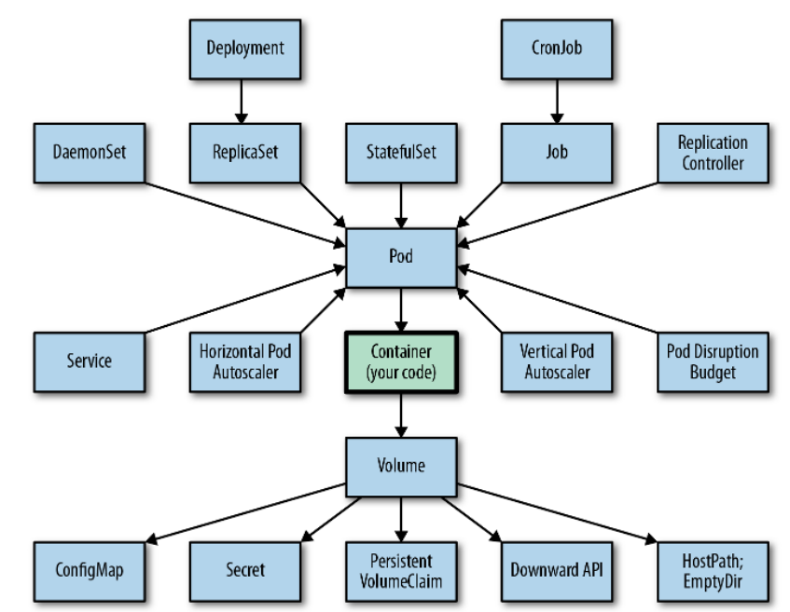
Prerequisite: K8s Concepts for Developers
Notes:
Pause Container holds the network namespace for the pod. Kubernetes creates pause containers to acquire the respective pod’s IP address and set up the network namespace for all other containers that join that pod.
Pause container make sure that there is a network stack to map, and it doesn’t change. Pause containers are a pod implementation detail where one pause container is used for each pod and shouldn’t be shown when listing containers that are members of pods. Pause containers hold the cgroups, reservations, and namespaces of a pod before its individual containers are created. The pause container’s image is always present, so the allocation of the pod’s resources is instantaneous.
By default, pause containers are hidden, but you can see them by running docker ps -a.

Slide 7
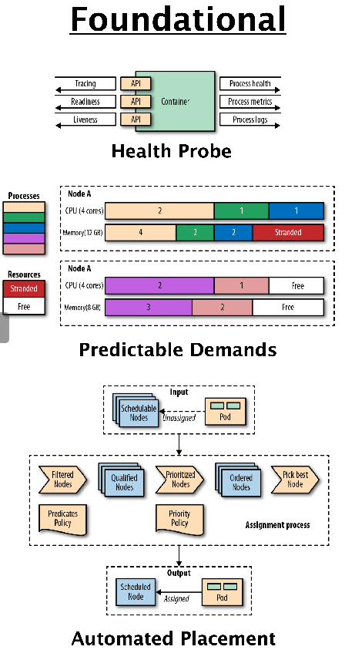
Foundational Patterns
Foundational patterns describe a number of fundamental principles that containerized applications
Must comply with in order to become good cloud-native citizens.
Adhering to these principles will help ensure your applications are suitable for automation.
Predictable Demands
Declarative Deployment
Health Probe
Managed Lifecycle
Automated Placement
Examples of Foundational Patterns

Slide 8
Pattern: Predictable Demands
Predictable Demands explains why every container should declare its resource profile and stay confined to the indicated resource requirements.
Problem: Defining application characteristics such as cpu, memory, persistence storage etc. and passing them to the managing platform is a fundamental prerequisite for a good cloud-native applications. This definition helps is below way:
Efficient scheduling: Kubernetes can make intelligent decisions for where to place a container on the cluster for most efficient hardware utilization. In an environment with shared resources among a large number of processes with different priorities, the only way for a successful coexistence is to know the demands of every process in advance.
Capacity Planning: Based on the particular service demands and the total number of services, we can do some capacity planning for the different environments and come up with the most cost-effective host profiles to satisfy the entire cluster demand.

Slide 9
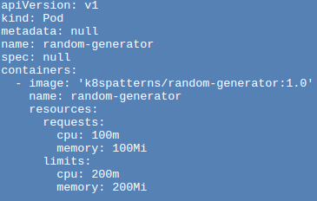
Predictable Demand: Resource Profile
Resource Profiles
Depending on whether you specify the requests , the limits , or both, the platform offers a different kind of Quality of Service (QoS).
Best-Effort
Pod that does not have any requests and limits set for its containers. Such a Pod is considered as the lowest priority and is killed first when the node where the Pod is placed runs out of incompressible resources.
Burstable
Pod that has requests and limits defined, but they are not equal (and limits is larger than requests as expected). Such a Pod has minimal resource guarantees, but is also willing to consume more resources up to its limit when available. When the node is under incompressible resource pressure, these Pods are likely to be killed if no Best-Effort Pods remain.
Guaranteed
Pod that has an equal amount of request and limit resources. These are the highest-priority Pods and guaranteed not to be killed before Best-Effort and Burstable Pods.
1
Initial resource request for CPU and memory
2
Upper limit until we want our application to grow at max
Compute resources in the context of Kubernetes are defined as something that can be requested by, allocated to, and consumed from a container. The resources are categorized as compressible (i.e., can be throttled, such as CPU) and incompressible (i.e., cannot be throttled, such as memory).
Example: For a Pod to be given a QoS class of Guaranteed:
Every Container in the Pod must have a memory limit and a memory request.
For every Container in the Pod, the memory limit must equal the memory request.
Every Container in the Pod must have a CPU limit and a CPU request.
For every Container in the Pod, the CPU limit must equal the CPU request.
https://kubernetes.io/docs/tasks/configure-pod-container/quality-service-pod/

Slide 10
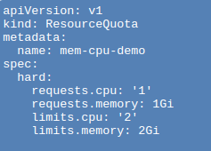
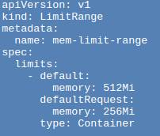
Predictable Demand: Resource Quota
ResourceQuota
LimitRange
With ResourceQuotas, the cluster admin can limit the total sum of computing resources (CPU, memory) and storage consumed. It can also limit the total number of objects (such as ConfigMaps, Secrets, Pods, or Services) created in a namespace.
For every Pod in the namespace, each container must have a memory request, memory limit, cpu request, and cpu limit.
The memory request total for all Pods in that namespace must not exceed 1 GiB.
The memory limit total for all Pods in that namespace must not exceed 2 GiB.
The CPU request total for all Pods in that namespace must not exceed 1 cpu.
The CPU limit total for all Pods in that namespace must not exceed 2 cpu.
With LimitRange, the cluster admin can set resource usage limits for each type of resource. In addition to specifying the minimum and maximum permitted amounts for different resource types and the default values for these resources.
If you create a Pod in the default-mem-example namespace, and any container within that Pod does not specify its own values for memory request and memory limit, then the control plane applies default values: a memory request of 256MiB and a memory limit of 512MiB.
https://kubernetes.io/docs/concepts/policy/limit-range/
https://kubernetes.io/docs/concepts/policy/resource-quotas/

Slide 11
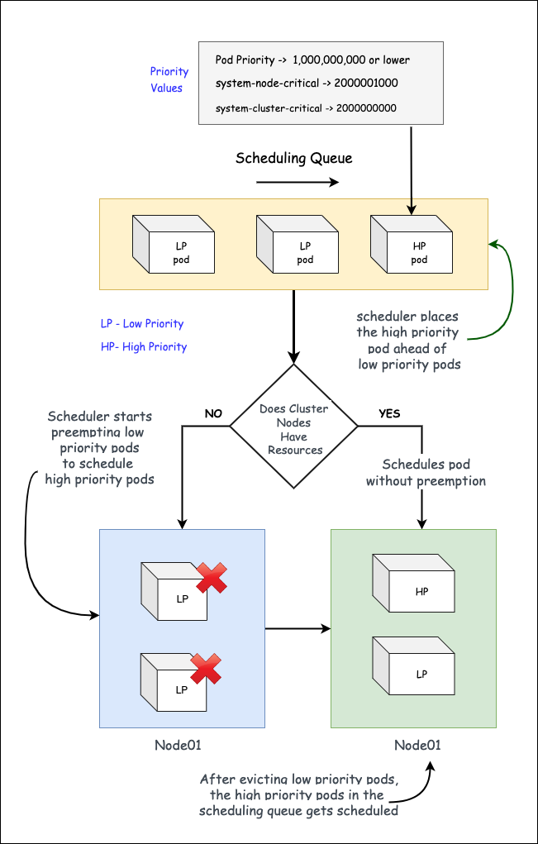
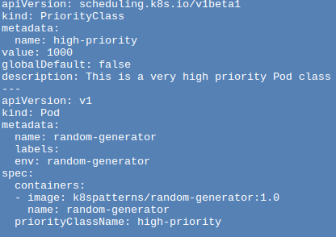
Predictable Demand: Pod Priority
A PriorityClass object can have any 32-bit integer value smaller than or equal to 1 billion.
Larger numbers are reserved for critical system Pods that should not normally be preempted or evicted.
A cluster admin should create one PriorityClass object for each such mapping that they want.
PriorityClass also has two optional fields: globalDefault and description.
The globalDefault field indicates that the value of this PriorityClass should be used for Pods without a priorityClassName. Only one PriorityClass with globalDefault set to true can exist in the system. If there is no PriorityClass with globalDefault set, the priority of Pods with no priorityClassName is zero.
The description field is an arbitrary string. It is meant to tell users of the cluster when they should use this PriorityClass.
Priority admission controller Handles Priority Class object.
Pod Priority
1
2
Pods can have priority. Priority indicates the importance of a Pod relative to other Pods. If a Pod cannot be scheduled, the scheduler tries to preempt (evict) lower priority Pods to make scheduling of the pending Pod possible.
https://kubernetes.io/docs/concepts/scheduling-eviction/pod-priority-preemption/

Slide 12
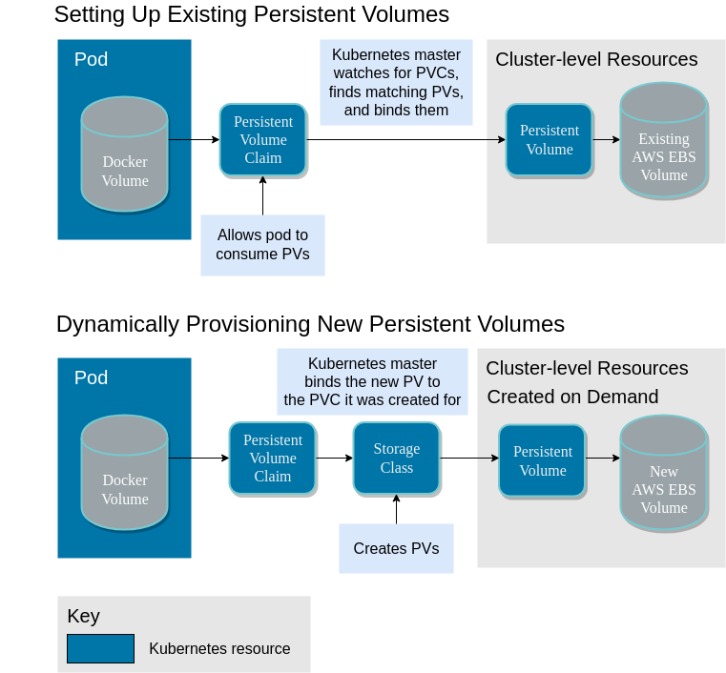
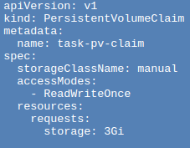
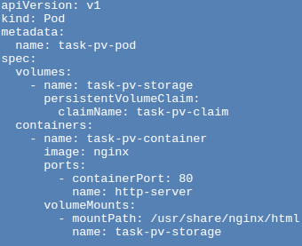
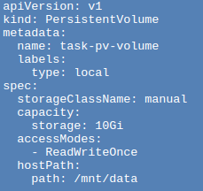
Predictable Demand: Runtime Dependencies
Runtime Dependencies
The scheduler evaluates the kind of volume a Pod requires, which affects where the Pod gets placed. If the Pod needs a volume that is not provided by any node on the cluster, the Pod is not scheduled at all.

Slide 13
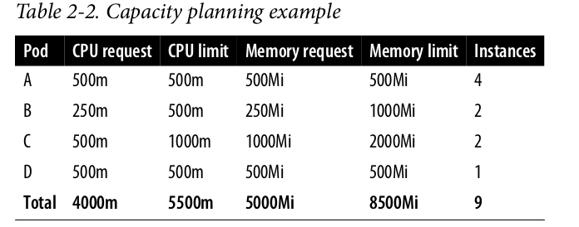
Capacity Planning
For example, for best hardware utilization, on a nonproduction cluster, you may have mainly Best-Effort and Burstable containers. In such a dynamic environment, many containers are starting up and shutting down at the same time, and even if a container gets killed by the platform during resource starvation, it is not fatal. On the production cluster where we want things to be more stable and predictable, the containers may be mainly of the Guaranteed type and some Burstable. If a container gets killed, that is most likely a sign that the capacity of the cluster should be increased.
You may even need to leave some room for autoscaling, build jobs, infrastructure containers, and more. Based on this information and the infrastructure provider, you can choose the most cost-effective compute instances that provide the required resources.

Slide 14
Pattern: Declarative Deployment
Declarative Deployment pattern encapsulates the upgrade and rollback processes of a group of containers and makes its execution a repeatable and automated activity
Problem:
With a growing number of microservices, continually updating and replacing them with newer versions becomes an increasing burden.
Performing these steps manually can lead to human errors.
Scripting properly can require a significant amount of effort and also can’t go beyond certain limit.

Slide 15
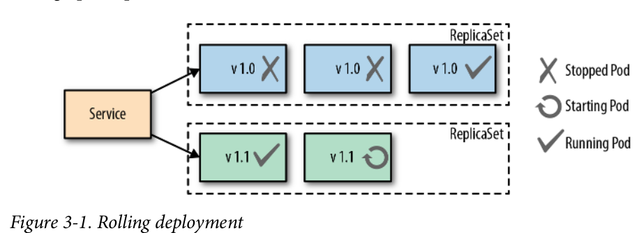
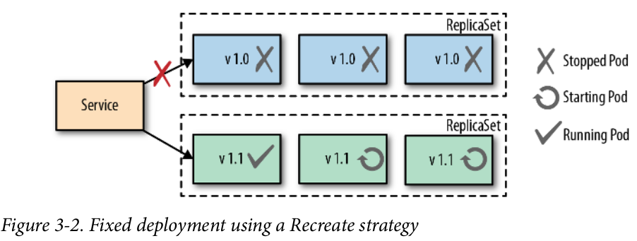
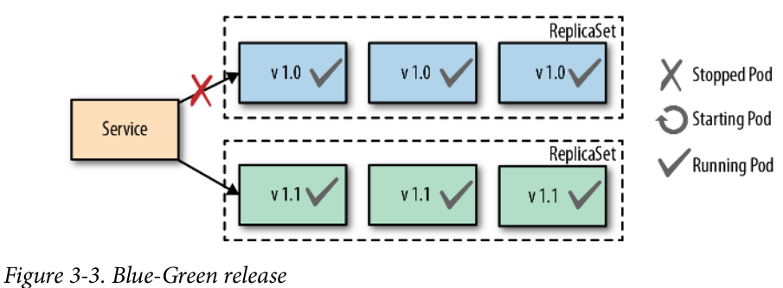
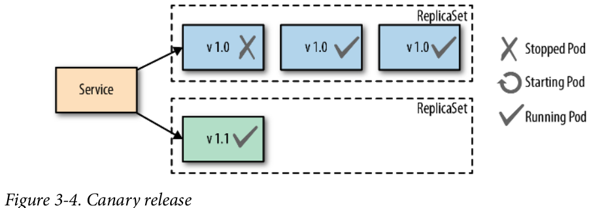
Declarative Deployment (Deployments)
Rolling Deployment
Fixed Deployment
Blue-Green Deployment
Canary Release

Slide 16
Pattern: Health Probe
Health Probe dictates that every container should implement specific APIs to help the platform observe and manage the application in the healthiest way possible. To be fully automatable, a cloud-native application must be highly observable by allowing its state to be inferred so that Kubernetes can detect whether the application is up and ready to serve requests. These observations influence the life-cycle management of Pods and the way traffic is routed to the application.
Examples:
An application hangs, but its process is still up and running. For example, a Java application may throw an OutOfMemoryError and still have the JVM process running.
An application may freeze because it runs into an infinite loop, deadlock, or some thrashing (cache, heap, process).
An application is not yet ready to process request or traffic.
NOTE: Health-check APIs are read-only endpoints the platform is continually probing to get application insight. It is a mechanism for the platform to extract information from the application.
Notes:
Application frameworks such as Spring actuator, Wild‐
Fly Swarm health check, Karaf health checks, or the MicroProfile spec for Java pro‐
vide implementations for offering Health Probes.

Slide 17
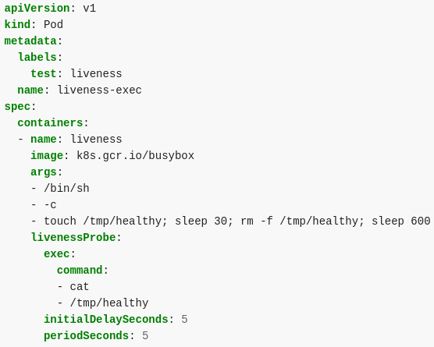
Health Probe: Liveness Probe
Liveness Probes
In the example configuration file, you can see that the Pod has a single Container.
The periodSeconds field specifies that the kubelet should perform a liveness probe every 5 seconds. The initialDelaySeconds field tells the kubelet that it should wait 5 seconds before performing the first probe.
To perform a probe, the kubelet executes the command cat /tmp/healthy in the target container.
If the command succeeds, it returns 0, and the kubelet considers the container to be alive and healthy.
If the command returns a non-zero value, the kubelet kills the container and restarts it.

Slide 18
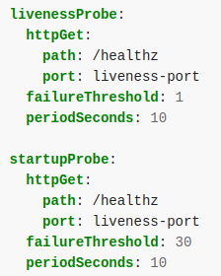
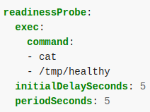
Health Probe: Startup probes & Readiness probes
Startup Probes
Startup probes provide a way to defer the execution of liveness and readiness probes until a container indicates it’s able to handle them. Kubernetes won’t direct the other probe types to a container if it has a startup probe that hasn’t yet succeeded.
With startup probe, the application will have a maximum of 5 minutes (30 * 10 = 300s) to finish its startup. Once the startup probe has succeeded once, the liveness probe takes over to provide a fast response to container deadlocks. If the startup probe never succeeds, the container is killed after 300s and subject to the pod's restartPolicy.
Readiness Probes
Readiness probes identify when a container is able to handle external traffic received from a service. Containers don’t become part of their services until they pass a readiness probe. A pod with containers reporting that they are not ready does not receive traffic through Kubernetes Services.

Slide 19
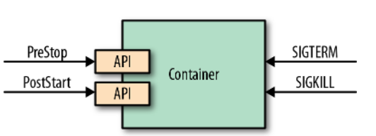
Pattern: Managed Lifecycle
Containerized applications managed by cloud-native platforms have no control over their lifecycle, and to be good cloud-native citizens, they have to listen to the events emitted by the managing platform and adapt their life cycles accordingly. The Managed Lifecycle pattern describes how applications can and should react to lifecycle events.
Driven by policies and external factors, a cloud-native platform may decide to start or stop the applications it is managing at any moment. Examples:
Pod is scheduled for deletion because of new version roll out.
Pod needs to be evicted.
Pod to needs to perform some task before shutting down.
Containers need to perform some initialization task at the beginning.

Slide 20
Managed Lifecycle: Prestop Hooks and Signals
Termination Life cycle: There are many reasons why Kubernetes might terminate a perfectly healthy container. Eg. a rolling update, drain a node, health probe failure etc.
1 - Pod is set to the “Terminating” State and removed from the endpoints list of all Services.
At this point, the pod stops getting new traffic. Containers running in the pod will not be affected.
2 - preStop Hook is executed
The preStop Hook is a special command or http request that is sent to the containers in the pod.
If your application doesn’t gracefully shut down when receiving a SIGTERM you can use this hook to trigger a graceful shutdown. Most programs gracefully shut down when receiving a SIGTERM, but if you are using third-party code or are managing a system you don’t have control over, the preStop hook is a great way to trigger a graceful shutdown without modifying the application.
3 - SIGTERM signal is sent to the pod
At this point, Kubernetes will send a SIGTERM signal to the containers in the pod. This signal lets the containers know that they are going to be shut down soon. Your code should listen for this event and start shutting down cleanly at this point. This may include stopping any long-lived connections (like a database connection or WebSocket stream), saving the current state, or anything like that.
4 - Kubernetes waits for a grace period
At this point, Kubernetes waits for a specified time called the termination grace period. By default, this is 30 seconds. It’s important to note that this happens in parallel to the preStop hook and the SIGTERM signal. Kubernetes does not wait for the preStop hook to finish.
If your app finishes shutting down and exits before the terminationGracePeriod is done, Kubernetes moves to the next step immediately.
If your pod usually takes longer than 30 seconds to shut down, make sure you increase the grace period. You can do that by setting the terminationGracePeriodSeconds option in the Pod YAML. For example, to change it to 60 seconds:
5 - SIGKILL signal is sent to pod, and the pod is removed
If the containers are still running after the grace period, they are sent the SIGKILL signal and forcibly removed. At this point, all Kubernetes objects are cleaned up as well.

Slide 21
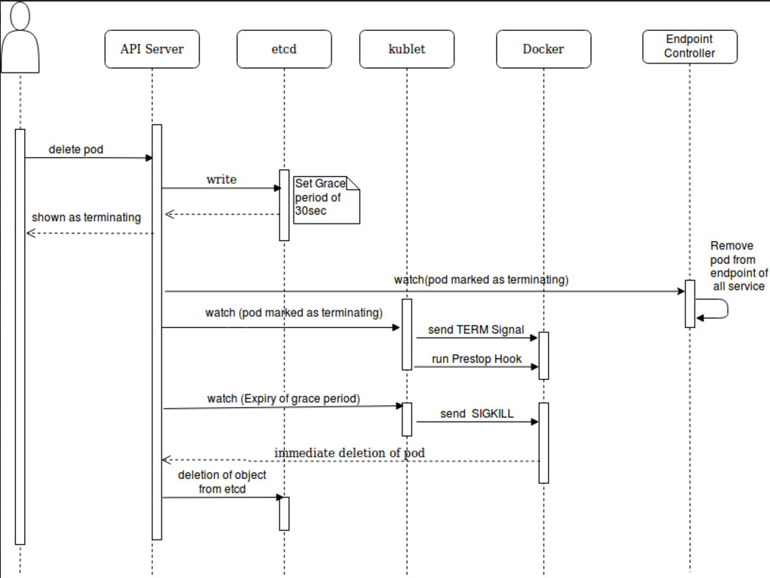
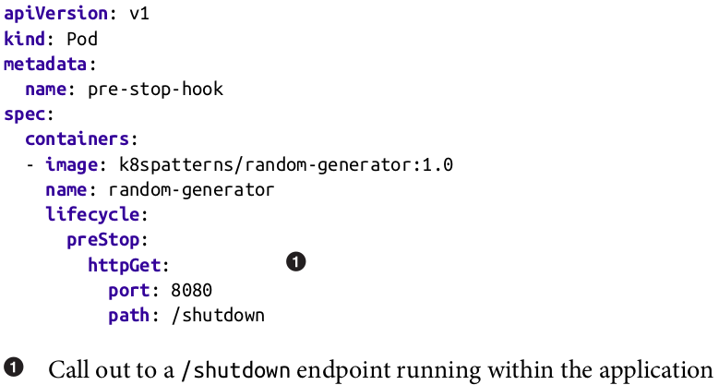
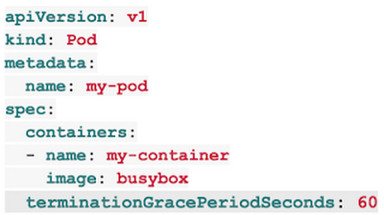
Managed Lifecycle (Solution Example)

Slide 22
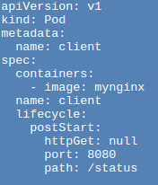
Managed Lifecycle: Poststart
Post Start: The postStart hook is a placeholder for any logic that you need to execute as soon as the container starts. Kubernetes sends the postStart event immediately after the Container is created. There is no guarantee, however, that the postStart handler is called before the Container's entrypoint is called. The postStart handler runs asynchronously relative to the Container's code, but Kubernetes' management of the container blocks until the postStart handler completes. The Container's status is not set to RUNNING until the postStart handler completes.
Some example use cases are many:
If the container is a client to an external API, you have to make sure that the API is up and running and capable of responding to requests before your container comes to service.
When the container needs to execute some activities before the primary process launches such as resetting users’ passwords or logging events to a log or database. etc.
postStart vs InitContainer
postStart scripts are executed using the same image as of the main container. Init containers can use the same or a different image than the one used by subsequent containers. So, if the tasks that you need to perform require a different base image, then you’d better use init containers.
postStart scripts are executed inside the same container. So, if the script you need to run is tightly coupled with the container, for example, you need to make configuration changes to the container itself, you should use postStart scripts.
All init containers must finish before the primary containers start. On the other hand, postStart scripts are specific to each container. So, container A uses its postStart scripts and launches, container B executes its postStart scripts and starts, and so on. So, if you are hosting more than one container on the same Pod and you need to run one or more container-agnostic tasks, you should use init containers. However, if each init script is specific to its container, then a postStart hook is the suitable choice.
Init containers start and stop before any other container starts. postStart scripts get executed in parallel with their containers. This means that the script may or may not run before the ENTRYPOINT of the container kicks in. If you need to be confident that the pre-launch logic is always executed before the main container does, then use init containers.

Slide 23
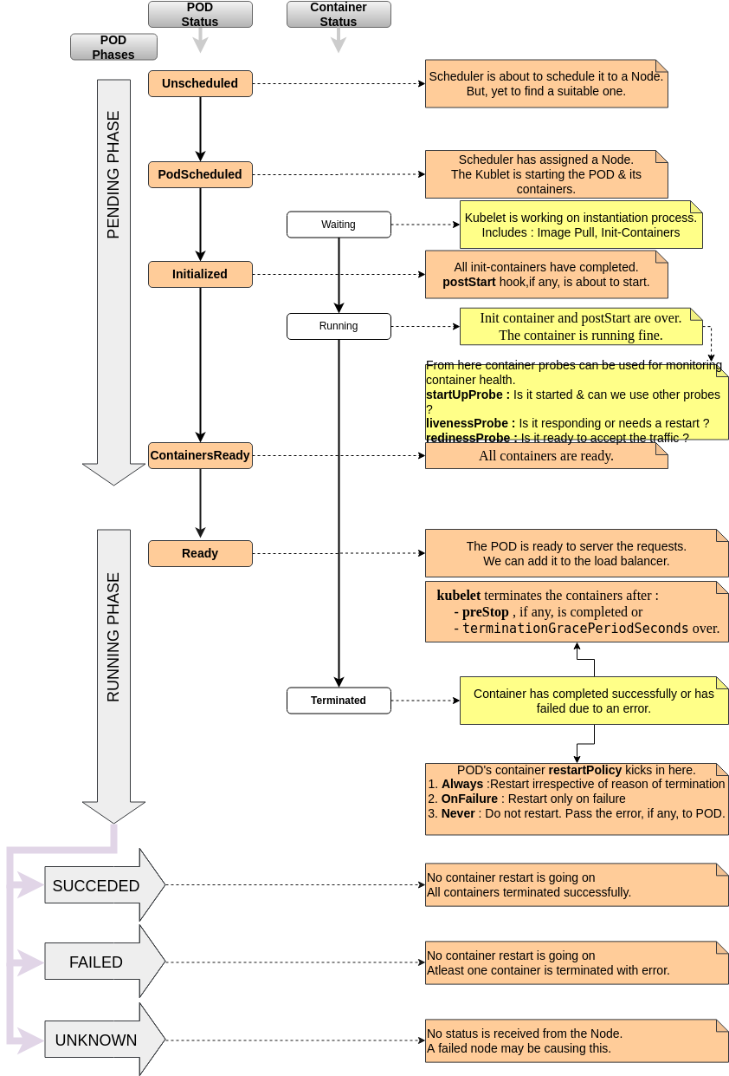
Pod Lifecycle at a Glance

Slide 24
Pattern: Automated Placement
Automated Placement explains how to influence workload distribution in a multi-node cluster. Placement is the core function of the Kubernetes scheduler for assigning new Pods to nodes satisfying container resource requests and honoring scheduling policies. This pattern describes the principles of Kubernetes’ scheduling algorithm and the way to influence the placement decisions from the outside.
Finding a suitable node for a pod is not a easy task because :
Containers have dependencies among themselves, dependencies to nodes, and resource demands, and all of that changes over time too.
The resources available on a cluster also vary over time, through shrinking or extending the cluster, or by having it consumed by already placed containers.
The way we place containers impacts the availability, performance, and capacity of the distributed systems as well.

Slide 25
Kube Scheduler
Few points about Kube scheduler:
kube-scheduler is the default scheduler for Kubernetes and runs as part of the control plane.
kube-scheduler is designed so that, if you want and need to, you can write your own scheduling component and use that instead.
For every newly created pod or other unscheduled pods, kube-scheduler selects an optimal node for them to run on.
However, every container in pods has different requirements for resources and every pod also has different requirements. Therefore, existing nodes need to be filtered according to the specific scheduling requirements.
In a cluster, Nodes that meet the scheduling requirements for a Pod are called feasible nodes.
If none of the nodes are suitable, the pod remains unscheduled until the scheduler is able to place it.
The scheduler finds feasible Nodes for a Pod and then runs a set of functions to score the feasible Nodes and picks a Node with the highest score among the feasible ones to run the Pod.
The scheduler then notifies the API server about this decision in a process called binding.

Slide 26
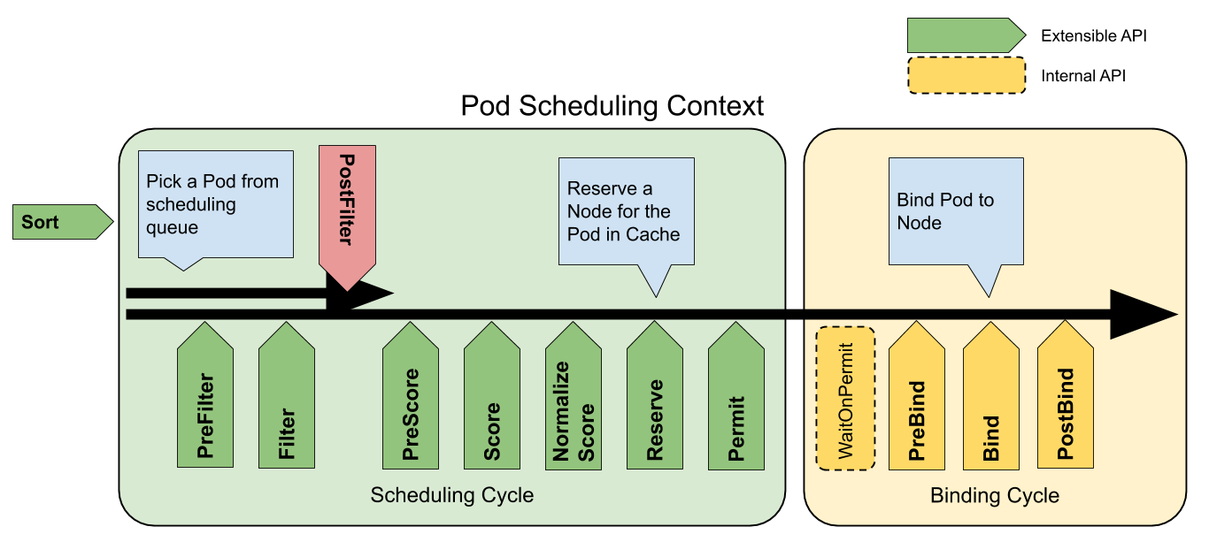
Scheduling Framework
queueSort: These plugins provide an ordering function that is used to sort pending Pods in the scheduling queue. Exactly one queue sort plugin may be enabled at a time.
preFilter: These plugins are used to pre-process or check information about a Pod or the cluster before filtering. They can mark a pod as unschedulable.
filter: These plugins are the equivalent of Predicates in a scheduling Policy and are used to filter out nodes that can not run the Pod. Filters are called in the configured order. A pod is marked as unschedulable if no nodes pass all the filters.
postFilter: These plugins are called in their configured order when no feasible nodes were found for the pod. If any postFilter plugin marks the Pod schedulable, the remaining plugins are not called.
preScore: This is an informational extension point that can be used for doing pre-scoring work.
score: These plugins provide a score to each node that has passed the filtering phase. The scheduler will then select the node with the highest weighted scores sum.
reserve: This is an informational extension point that notifies plugins when resources have been reserved for a given Pod. Plugins also implement an Unreserve call that gets called in the case of failure during or after Reserve.
permit: These plugins can prevent or delay the binding of a Pod.
preBind: These plugins perform any work required before a Pod is bound.
bind: The plugins bind a Pod to a Node. bind plugins are called in order and once one has done the binding, the remaining plugins are skipped. At least one bind plugin is required.
postBind: This is an informational extension point that is called after a Pod has been bound.

Slide 27
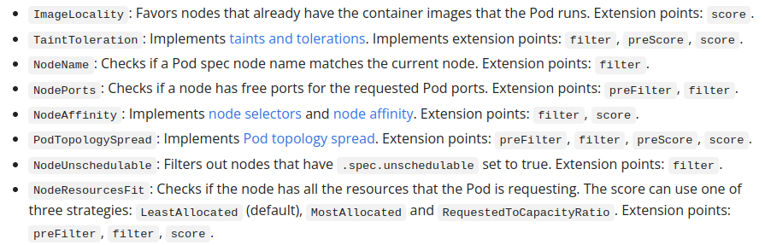
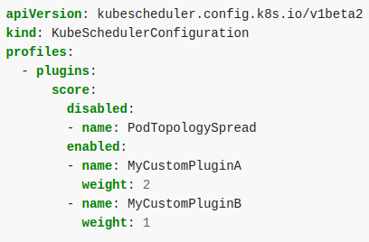
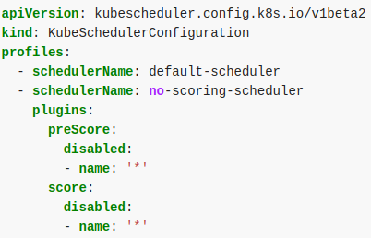
Scheduling Framework
https://kubernetes.io/docs/reference/scheduling/config/
https://kubernetes.io/docs/tasks/extend-kubernetes/configure-multiple-schedulers/
…
Example how you can disable default plugin and enable custom plugin
Example scheduler will run with two profiles: one with the default plugins and one with custom, Pods that want to be scheduled according to a specific profile can include the corresponding scheduler name in its .spec.schedulerName

Slide 28
Automated Placement (Solutions)
NodeName
NodeSelector
Node Affinity
Pod Affinity and Anti-affinity
Taints and Tolerations
Pod Priority and Preemption

Slide 29
Automated Placement (Examples)
apiVersion: v1
kind: Pod
metadata:
name: nginx
spec:
nodeName: instance-1
containers:
- name: nginx
image: nginx:latest
ports:
- containerPort: 80
$ kubectl label nodes instance-2 disktype=ssd
------
apiVersion: v1
kind: Pod
metadata:
name: nginx-2
spec:
containers:
- name: nginx
image: nginx:latest
ports:
- containerPort: 80
nodeSelector:
disktype: ssd
$kubectl taint nodes node1 key1=value1:NoSchedule
------
apiVersion: v1
kind: Pod
metadata:
name: nginx
labels:
env: test
spec:
containers:
- name: nginx
image: nginx
imagePullPolicy: IfNotPresent
tolerations:
- key: "key1"
operator: "Equal"
value: "value1"
effect: "NoSchedule"
apiVersion: v1
kind: Pod
metadata:
name: with-node-affinity
spec:
affinity:
nodeAffinity:
requiredDuringSchedulingIgnoredDuringExecution:
nodeSelectorTerms:
- matchExpressions:
- key: kubernetes.io/os
operator: In
values:
- linux
preferredDuringSchedulingIgnoredDuringExecution:
- weight: 1
preference:
matchExpressions:
- key: another-node-label-key
operator: In
values:
- another-node-label-value
containers:
- name: with-node-affinity
image: nginx:latest
apiVersion: v1
kind: Pod
metadata:
name: with-pod-affinity
spec:
affinity:
podAffinity:
requiredDuringSchedulingIgnoredDuringExecution:
- labelSelector:
matchExpressions:
- key: security
operator: In
values:
- S1
topologyKey: topology.kubernetes.io/zone
podAntiAffinity:
preferredDuringSchedulingIgnoredDuringExecution:
- weight: 100
podAffinityTerm:
labelSelector:
matchExpressions:
- key: security
operator: In
values:
- S2
topologyKey: topology.kubernetes.io/zone
containers:
- name: with-pod-affinity
image: k8s.gcr.io/pause:2.0
Example: Node name
Example: Node Selector
Example: Taint and Toleration
Example: Node Affinity
Example: Pod Affinity and Anti-affinity

Slide 30
Automated Placement: Descheduler
Deschdeuler: As Kubernetes clusters are very dynamic and their state changes over time, there may be desire to move already running pods to some other nodes for various reasons:
Some nodes are under or over utilized.
The original scheduling decision does not hold true any more, as taints or labels are added to or removed from nodes, pod/node affinity requirements are not satisfied any more.
Some nodes failed and their pods moved to other nodes.
New nodes are added to clusters.
Consequently, there might be several pods scheduled on less desired nodes in a cluster. Descheduler, based on its policy, finds pods that can be moved and evicts them. Please note, in current implementation, descheduler does not schedule replacement of evicted pods but relies on the default scheduler for that.
https://github.com/kubernetes-sigs/descheduler
Some strategy:
RemoveDuplicates
This strategy ensures that only a single Pod associated with a ReplicaSet or Deployment is running on a single node. If there are more Pods than one, these excess Pods are evicted.
LowNodeUtilization
This strategy finds nodes that are underutilized and evicts Pods from other over utilized nodes, hoping these Pods will be placed on the underutilized nodes, leading to better spread and use of resources
RemovePodsViolatingInterPodAntiAffinity
This strategy evicts Pods violating interpod antiaffinity rules, which could happen when the antiaffinity rules are added after the Pods have been placed on the nodes.

Slide 31
Example (Descheduler)
apiVersion: "descheduler/v1alpha1"
kind: "DeschedulerPolicy"
strategies:
"RemoveDuplicates":
enabled: true
params:
removeDuplicates:
excludeOwnerKinds:
- "ReplicaSet"

Slide 32
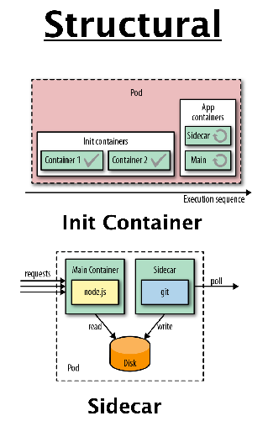
Structural Patterns
The patterns in this category are focused on structuring and organizing containers in a Pod to satisfy different use cases. The forces that affect containers in the same Pods result in these patterns.
Init container
Sidecar
Adapter
Ambassador
Examples of Structural Patterns

Slide 33
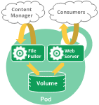
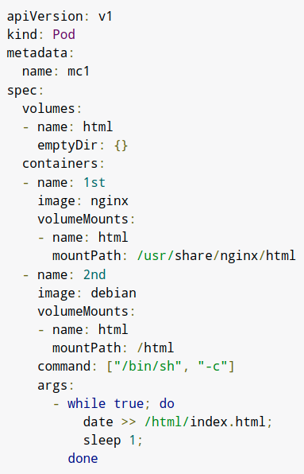
Prerequisite: Multi containers
A Pod can encapsulate an application composed of multiple co-located containers that are tightly coupled and need to share resources. These co-located containers form a single cohesive unit of service—for example, one container serving data stored in a shared volume to the public, while a separate sidecar container refreshes or updates those files. The Pod wraps these containers, storage resources, and an ephemeral network identity together as a single unit.
Containers in a Pod runs on a "logical host": they use the same network namespace (same IP address and port space), IPC namespace and, optionally, they can use shared volumes. Therefore, these containers can efficiently communicate, ensuring data locality. Also, Pods allow managing several tightly coupled application containers as a single unit.
Use cases:
The primary purpose of a multi-container Pod is to support co-located, co-managed helper processes for a main program. There are some general patterns of using helper processes in Pods:
Sidecar containers "help" the main container. For example, log or data change watchers, monitoring adapters, and so on.
Proxies, bridges, adapters connect the main container with the external world. For example, Apache HTTP server or nginx can serve static files and act as a reverse proxy to a web application in the main container to log and limit HTTP request.
Notes:
https://linchpiner.github.io/k8s-multi-container-pods.html

Slide 34
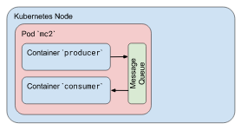
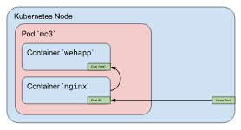
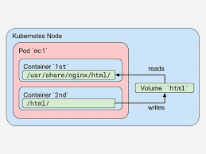
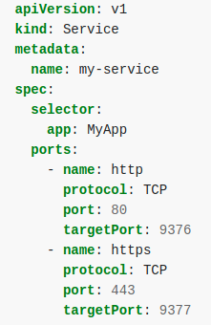
Prerequisite: Multi containers
Communication Between Containers in a Pod:
Shared volumes: In Kubernetes, you can use a shared Kubernetes Volume as a simple and efficient way to share data between containers in a Pod. For most cases, it is sufficient to use a directory on the host that is shared with all containers within a Pod.
IPC: Containers in a Pod share the same IPC namespace and they can also communicate with each other using standard inter-process communications like SystemV semaphores or POSIX shared memory.
Network: communicate on localhost
Other features:
Multiport for each container: It’s quite common case when several containers in a Pod listen on different ports and you need to expose all this ports. You can use two services or one service with two exposed ports.
Container start order: Currently, all containers in a Pod are being started in parallel and there is no way to define that one container must be started after other container
Notes:
https://linchpiner.github.io/k8s-multi-container-pods.html

Slide 35
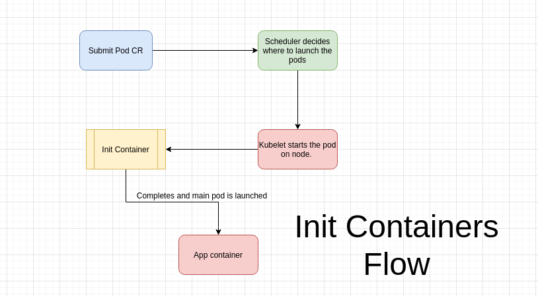
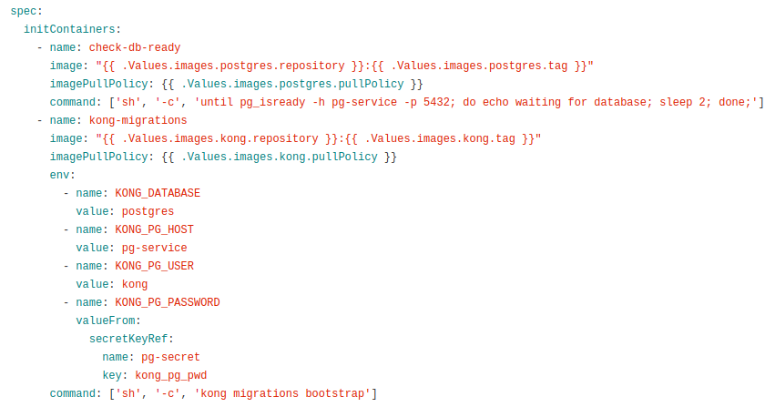
Structural Pattern: Init container
init Containers enable separation of concerns by providing a separate life cycle for initialization-related tasks distinct from the main application containers. This pattern introduces a fundamental Kubernetes concept that is used in many other patterns when initialization logic is required.
Init Containers are similar to Java constructor, but at Pod level rather than class level. So if you have one or more containers in a Pod that represent your main application, these containers
may have prerequisites before starting up. Examples:
These may include setting up special permissions on the filesystem.
Database schema setup
Initializing logic may require tools and libraries that cannot be included in the application image.
For security reasons, the application image may not have permissions to perform the initializing activities.
Alternatively, you may want to delay the startup of your application until an external dependency is satisfied.
For all these kinds of use cases, Kubernetes uses init containers as implementation of this pattern, which allow separation of initializing activities from the main application duties.
MEP example

Slide 36
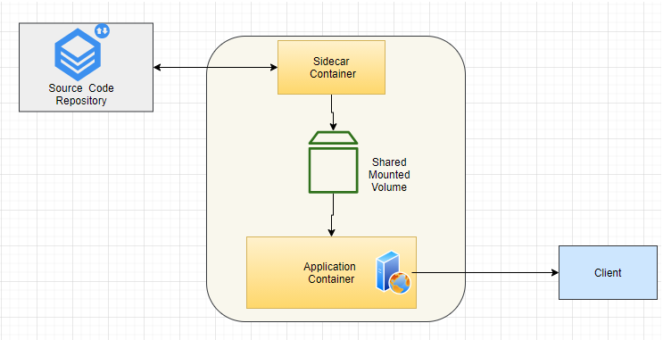
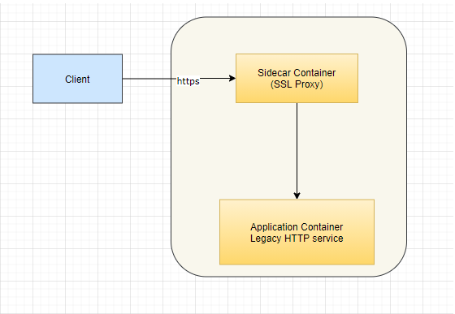
Sidecar
Sidecar pattern is about attaching helper container to main application container. Two containers co exist in a pod. One container is main application container that has core application/service logic. Second container is to help/enhance functionality of main container. Sometimes sidecar container is used to fix some environmental issues/limitations of existing legacy application. Both containers share common resources like file system and network.
Some common use cases of this pattern are:
Fixing transport or port issues of existing legacy application. Existing application may have some hard coded or difficult to change port on which it listens. Or existing application may not have HTTPS support and it may be required now by security team. Sidecar container can accept HTTPS traffic and terminate it at that level and forward request to application container on HTTP.
File syncing/Watching — Sidecar container can monitor some repository and pull down code or config changes. It’ll put those in shared volume that can be accessed by main application.
Standardizing logging formats.

Slide 37
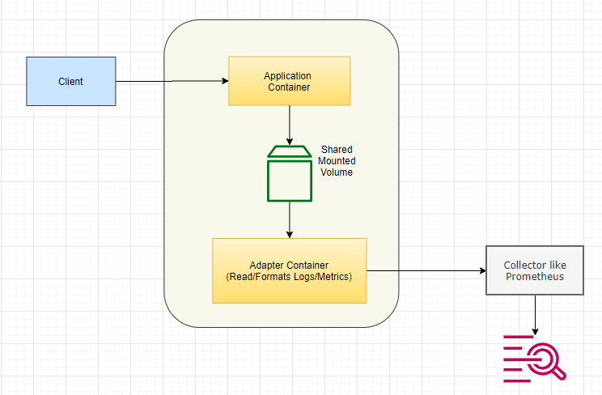
Adapter
The Adapter pattern takes a heterogeneous containerized system and makes it conform to a consistent, unified interface with a standardized and normalized format that can be consumed by the outside world. The Adapter pattern inherits all its characteristics from the Sidecar, but has the single purpose of providing adapted access to the application.
We may need to expose logs/metrics in standard format to some aggregator for alerting/monitoring. But different applications may be exposing this information in different formats. Helper container can present unified interface.

Slide 38
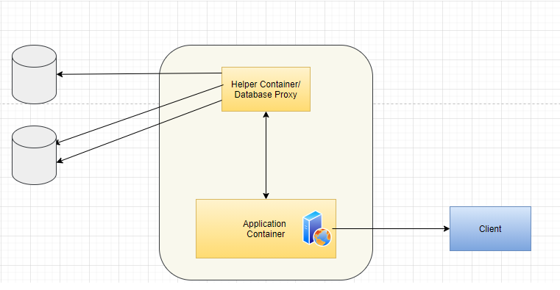
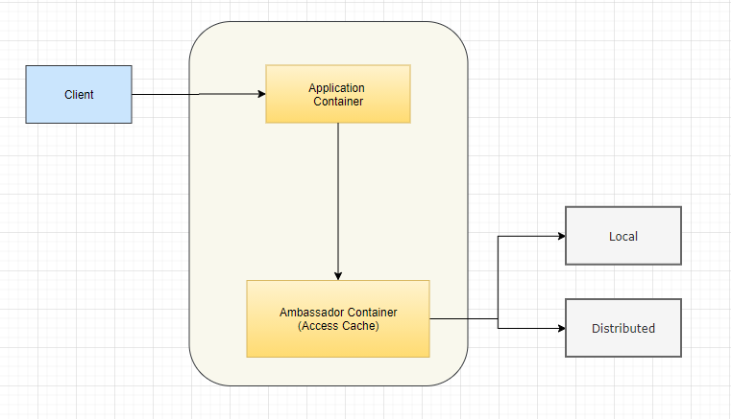
Ambassador
The Ambassador pattern is a specialized Sidecar responsible for hiding complexity and providing a unified interface (to the application) for accessing services outside the Pod.
This patterns relieves main application container from having intimate knowledge of consumed service by providing interface in standard or well known format. It can also be useful when some target service must be selected based on load etc.
Examples:
Accessing cache, accessing some legacy database or service that requires some non-standard protocol or data format.
Target service must be selected based on some condition etc.

Slide 39
Configuration Patterns
Every application needs to be configured, and the easiest way to do so is by storing configurations in the source code.
Configurations are very rigid.
You can’t change it based on requirements.
Sometime need values from running environment.
The patterns in this groups are all about customizing and adapting applications with external configurations for various environments

Slide 40
Configuration Patterns
Env Variables
Config Map
Secrets
Immutable configuration
Configuration Template

Slide 41
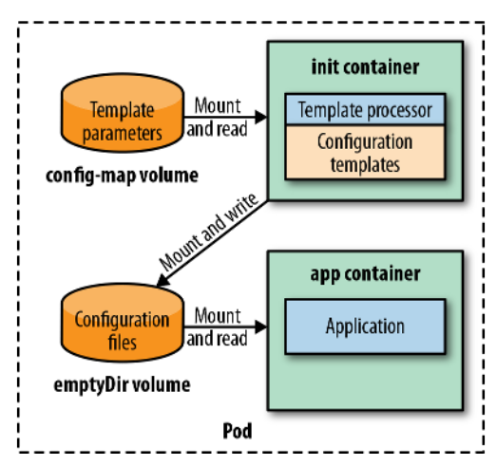
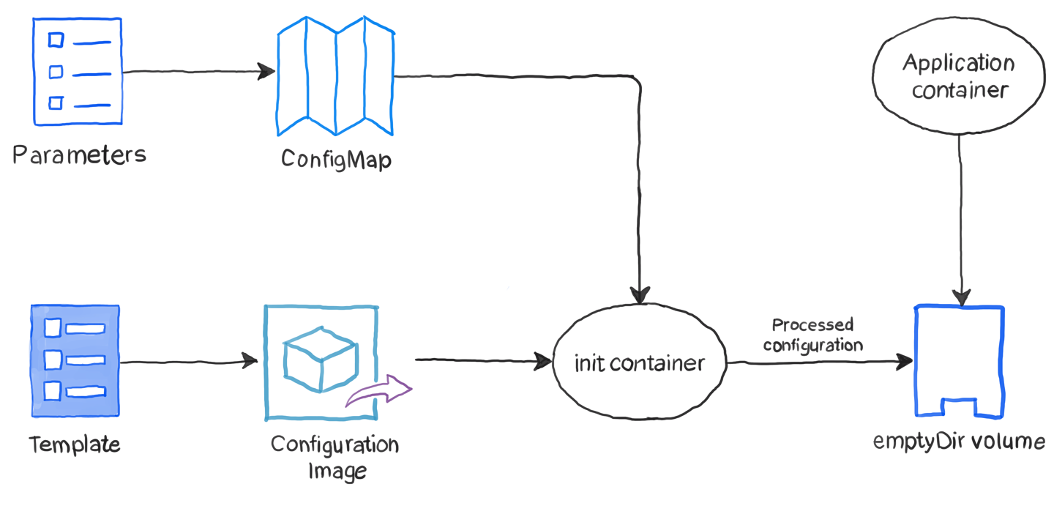
Configuration Template
The Configuration Template pattern builds on top of Configuration Resource and is especially suited when we need to operate applications in different environments with similar complex configurations.
Problems:
Sometimes configuration files can get large and complex. Putting the configuration files directly into ConfigMaps can be problematic since they have to be correctly embedded in the resource definition.
The size of configurations is another consideration, as there is a limit on the sum of all values of ConfigMaps or Secrets, which is 1 MB (a limit imposed by the underlying backend store Etcd).
Large configuration files typically differ only slightly for the different execution environments. This similarity leads to a lot of duplication and redundancy in the ConfigMaps because each environment has mostly the same data.
https://www.weave.works/blog/the-configuration-template-pattern

Slide 42
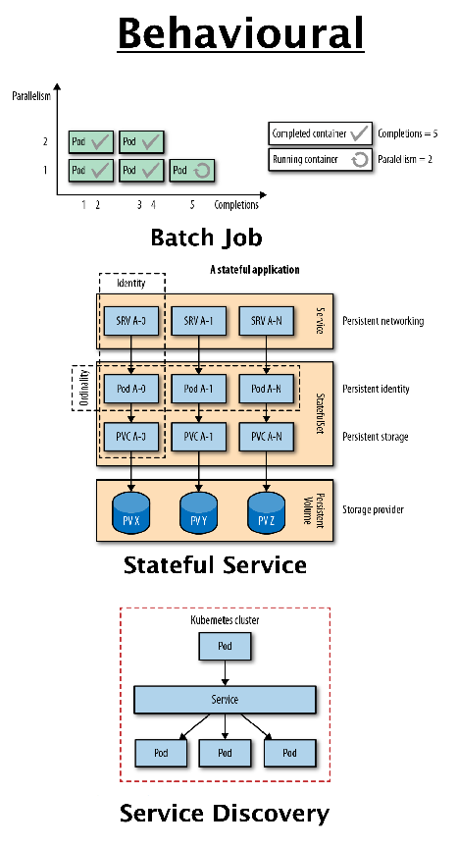
Behavioral Patterns
These patterns describe the life-cycle guarantees of the Pods ensured by the managing platform. Depending on the type of workload, a Pod might run until completion as a batch job or be scheduled to run periodically. It might run as a daemon service or singleton. Picking the right life-cycle management primitive will help you run a Pod with the desired guarantees.
Examples of Behavioral Patterns

Slide 43
Jobs
Batch Job describes how to run an isolated, atomic unit of work until completion. This pattern is suited for managing isolated atomic units of work in a distributed environment.

Slide 44
Daemon Service

Slide 45
Singleton Service

Slide 46
Stateful Service
Stateful Service describes how to create and manage distributed stateful applications with Kubernetes. Such applications require features such as persistent identity, networking, storage, and ordinality. The StatefulSet primitive provides these building blocks with strong guarantees ideal for the management of stateful applications.

Slide 47
Service Discovery
Service Discovery explains how clients can access and discover the instances that are providing application services. For this purpose, Kubernetes provides multiple mechanisms, depending on whether the service consumers and producers are located on or off the cluster.

Slide 48
Self Awareness

Slide 49
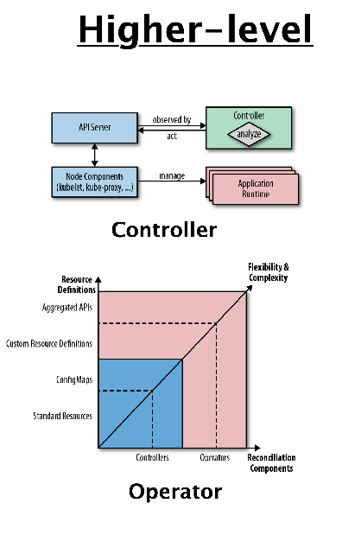
Advanced Patterns
The patterns in this category are more complex and represent higher-level application management patterns. Some of the patterns here (such as Controller) are timeless, and Kubernetes itself is built on top of them.
Examples of Advanced Patterns

Slide 50
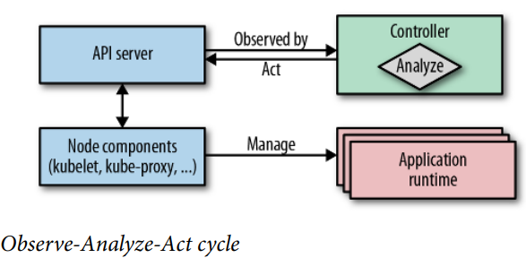
Controller
Controller is a pattern that actively monitors and maintains a set of Kubernetes resources in a desired state. The heart of Kubernetes itself consists of a fleet of controllers that regularly watch and reconcile the current state of applications with the declared target state. This pattern describes how to leverage this core concept for extending the platform for our own applications.
Observe
Discover the actual state by watching for events issued by Kubernetes when an observed resource changes.
Analyze
Determine the differences from the desired state.
Act
Perform operations to drive the actual to the desired state.

Slide 51
Operator

Slide 52
Elastic Scale

Slide 53
Kubernetes Features

Slide 54



K8S Extensibility
Extensibility: Kubernetes is highly configurable and extensible.
Kubernetes Extension points
1 Kubectl plugins
2 API Access Extensions Plugin
3 Custom Resources
4 Scheduler Extensions
5 Controllers/Operators
6 Network Plugins
7 Storage Plugins & device Plugins

Slide 55
Infrastructure Extensibility
The kubelet runs on servers, and helps pods appear like virtual servers with their own IPs on the cluster network. Network Plugins allow for different implementations of pod networking.
The kubelet also mounts and unmounts volumes for containers. New types of storage can be supported via Storage Plugins.
Device Plugins ??

Slide 56

API Extensibility
Users often interact with the Kubernetes API using kubectl. Kubectl plugins extend the kubectl binary. They only affect the individual user's local environment, and so cannot enforce site-wide policies.
The API server handles all requests. Several types of extension points in the API server allow authenticating requests, or blocking them based on their content, editing content, and handling deletion. These are described in the API Access Extensions section.

Slide 57
API Extensibility
Much of the behavior of Kubernetes is implemented by programs called Controllers which are clients of the API server. Controllers are often used in conjunction with Custom Resources.

Slide 58
THANK YOU

Slide 59
Backup Slides

Slide 60


Cloud Native Application
Cloud Native Applications charateristics:
Use cloud platform services.
Scale horizontally.
Scale automatically, using proactive and reactive actions.
Handle node and transient failures without degrading.
Feature non-blocking asynchronous communication in a loosely coupled architecture.
Microservices architecture style: Microservice architecture principles lets you create implementations that are optimized for scale, resiliency, and pace of change, which are common requirements for any modern software today.
K8s Patterns: Creating modular, reusable containers that are good cloud-native citizens is another fundamental prerequisite. With a growing number of containers in every organization comes the need to manage them using more effective methods and tools.

Slide 61

Java concept and k8s similarity

Slide 62

K8s resources in a typical Cloud native application
https://livebook.manning.com/book/kubernetes-in-action/chapter-17/

Slide 63
Useful Links
https://www.redhat.com/cms/managed-files/cm-oreilly-kubernetes-patterns-ebook-f19824-201910-en.pdf

